Slide 1

Social Media Marketing

Slide 2
Why Social Media Strategy?
Internet Revolution
The social web still is growing fast
Purchasing decisions are influenced by social media
Lack of strategy hands the advantage to competitors
Your customers are active on social media
Reputations can be enhanced or destroyed on social networks

Slide 3
What is Social Media Strategy?
Step by step methodological approach
Major Objectives;
  Customer Engagement
  Brand Building
  Lead generation and conversion
  Sales
  Innovation and new product development
  Human Resource
  Grow business partnerships

Slide 4
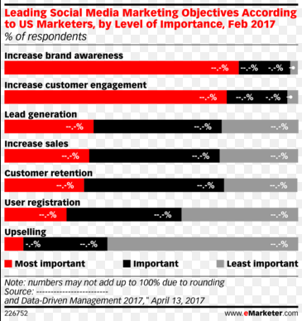

Slide 5
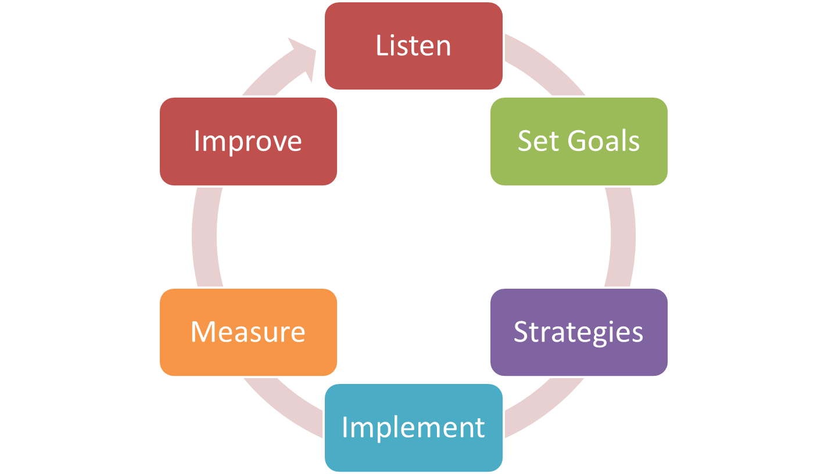
How to build a successful strategy

Slide 6
Successful Social Media Strategy
Listen
Listen:- e.g. Paytm Karo
  Listening Exercise: There was too many online payment, net banking, debit card, credit card etc.
  Strategy and result: Paytm has not approached as one more payment method.
  Company changed the perception to a new frame of reference i.e. new currency.

Slide 7
Listen
Tools to Listen
Social media listening tool simplify the listening process.
Provide quick and effective way to collect, process and analyze the huge data.
Free listening tools
  Google alerts
  Google trends

Slide 8
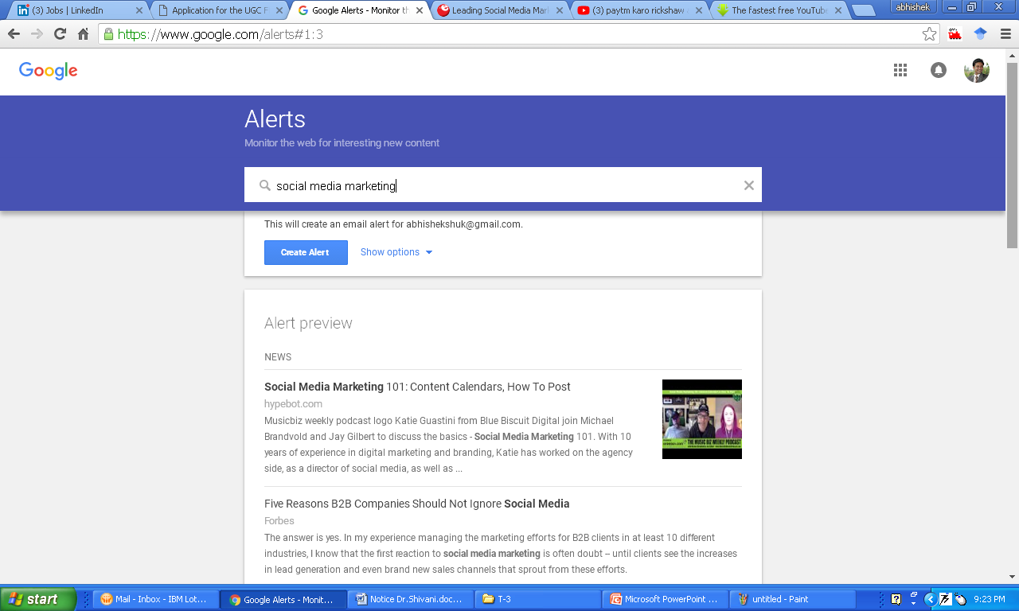
Listen
Toole to Listen

Slide 9
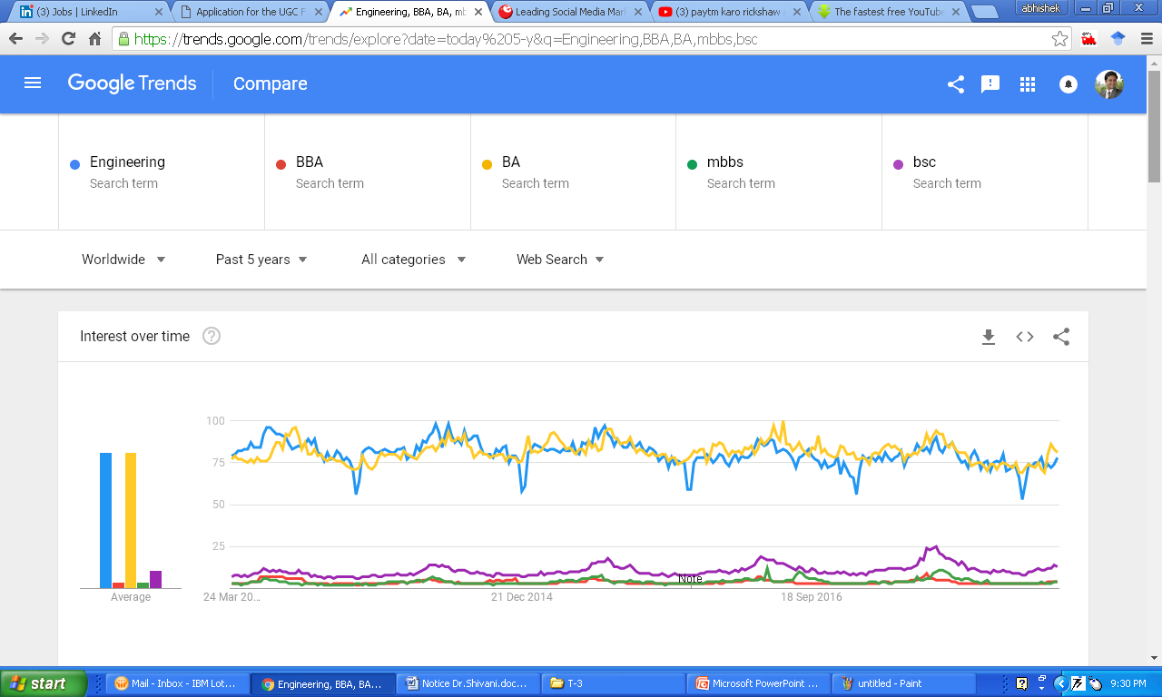

Slide 10
